Slide 1

SRI CHANDRASEKHARENDRA SARASWATHI VISWA MAHA VIDHYALAYA
(Deemed to be university u/s 3 of UGC act 1956) (Accredited with “A” by NAAC) Enathur, Kanchipuram – 631561. Tamilnadu www.kanchiuniv.ac.in
DEPARTMENT OF COMPUTER SCIENCE & ENGINEERING
BCSF186Z90-CIP Project Work
AI MATH TUTOR
11239a050 KONGARA DHEERAJ
11239A090 STUTIPRIYA SHADANGI
Guided By
Dr.M.Saraswathi, Assistant Professor, CSE
University Review: 29-04-2026

Slide 2
Overview:
AI Math Tutor Pro is a web-based adaptive mathematics learning platform built with
Python/Streamlit.
Two Roles:
Students: access personalized worksheets (Easy/Medium/Hard) and an AI chat tutor
Teachers: manage class enrolment, upload questions via CSV, and view dashboards
Core Capabilities:
AI-generated MCQs via Perplexity AI (sonar model) or teacher-uploaded CSV question bank instant auto-grading, score tracking, missed-question retry,and daily streak counter.
Persistent storage in SQLite — subjects, question_bank, performance, chat_history tables
Technology Stack: Python 3, Streamlit, SQLite, Perplexity AI API, OpenAI SDK

Slide 3
AI MATH TUTOR:
Abstract :
AI Math Tutor is a Streamlit-based adaptive learning platform for school mathematics.
Students access personalised worksheets (Easy / Medium / Hard) and an AI chat tutor.
Teachers manage enrolment, upload questions via CSV, and monitor performance dashboards.
The system uses a Perplexity AI API for dynamic question generation and guided tutoring.
SQLite stores student performance, chat history, and study materials for persistent tracking.
Keywords: Adaptive learning, AI tutoring, Mathematics education, MCQ generation, Perplexity AI, Streamlit.

Slide 4
AI MATH TUTOR:
Problem Statement:
Students lack access to personalised, on-demand math practice with instant result.
Existing platforms use static question banks — questions do not adapt to student skill level.
Teachers have no real-time visibility into which students are struggling or falling behind.
No low-cost solution combines AI question generation, guided tutoring, and teacher oversight in one deployable tool.

Slide 5
AI MATH TUTOR: Literature Survey
S.no | Author(s) | Year | Title | Finding
1. | Lin, Huang & Lu | 2023 | AI in Intelligent Tutoring Systems toward Sustainable Education | AI-driven ITS enable personalized learning and improve engagement
2. | Liu et al. | 2024 | Generative Intelligent Tutoring Systems with GPT-4 | GPT-based tutors and dynamic content generation
3. | Fernández-Herrero | 2024 | Affective Intelligent Tutoring Systems Review | Emotion-aware AI tutors
4. | Létourneau et al. | 2025 | AI-Driven Intelligent Tutoring Systems in K-12 Education | Rapid growth of AI tutoring
5. | Hariyanto et al. | 2025 | AI in Adaptive Education | Adaptive learning algorithms personalize instruction
6. | Latif, Liu & Zhai | 2026 | Intelligent and Robot Tutoring Systems Review | AI and robotic tutors expand interactive learning

Slide 6
AI MATH TUTOR:
Existing System & its Drawbacks :
Khan Academy / Mathway
Static content; does not adapt to individual student difficulty level
No teacher control panel or class-specific enrolment management
General-purpose; not designed for classroom-aligned curriculum
AI tutoring either absent or locked behind expensive subscriptions
No persistent per-student performance history for teacher analysis

Slide 7
AI MATH TUTOR:
Proposed Method & System Architecture
Modules: Authentication | Student Worksheet | AI Tutor | Progress | Teacher Dashboard
Algorithm: Adaptive difficulty selection based on student past performance percentile
Question Source: Perplexity AI (sonar model) OR Teacher-uploaded CSV bank
Steps: Login → Select topic & difficulty → Generate worksheet → Submit → Score Dashboard
Storage: SQLite (subjects, difficulty_levels, question_bank, performance, chat_history tables)
Framework: Streamlit (Python) | REST calls to Perplexity AI API for tutor & AI questions

Slide 8
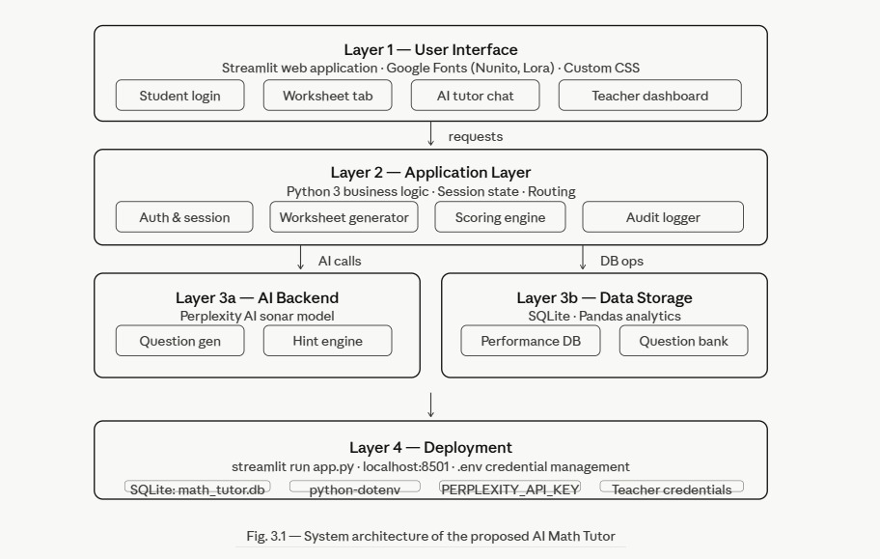

Slide 9
Steps for Implementation:
Step 1 — Environment Setup: pip install streamlit openai python-dotenv pandas; create .env with PERPLEXITY_API_KEY and teacher credentials
Step 2 — Database Initialisation: Run create_database() to auto-create all SQLite tables and seed 3 difficulty levels
Step 3 — Teacher Onboarding: Teacher logs in → adds students (single or CSV bulk) → uploads question CSV → adds study material
Step 4 — Student Onboarding: Students receive credentials → log in → see enrolled subjects → attempt first worksheet
Step 5 — Worksheet Session: Select topic + difficulty + source → Generate → Answer 5 MCQs → Submit → Review → Retry missed
Step 6 — AI Tutor Session: Open AI Tutor tab → type or tap quick prompt → receive guided hints → chat persists across sessions
Step 7 — Monitoring: Teacher checks scoreboard weekly → flags at-risk students → drills into individual reports → exports CSV

Slide 10
PROCESS:
Student Flow:
Login with credentials verified against student_logins table
Select subject (only enrolled subjects shown) and difficulty
Choose question source: Teacher Uploads or Perplexity AI
Click Generate — 5 MCQs fetched/generated, choices shuffled randomly
Answer questions; optional per-question AI hints available before submit
Submit → score computed → result stored in DB → feedback shown
Missed questions offered for immediate retry practice

Slide 11
PROCESS:
Teacher Flow:
Login with subject-specific credentials
Dashboard loads class scoreboard, question counts, at-risk flags
Add/remove students, reset passwords, manage enrolment via CSV bulk upload
Upload question CSVs in Append or Replace mode
Upload study material (text notes, PDF, or image)
Drill down into any student's attempt history and score trend

Slide 12
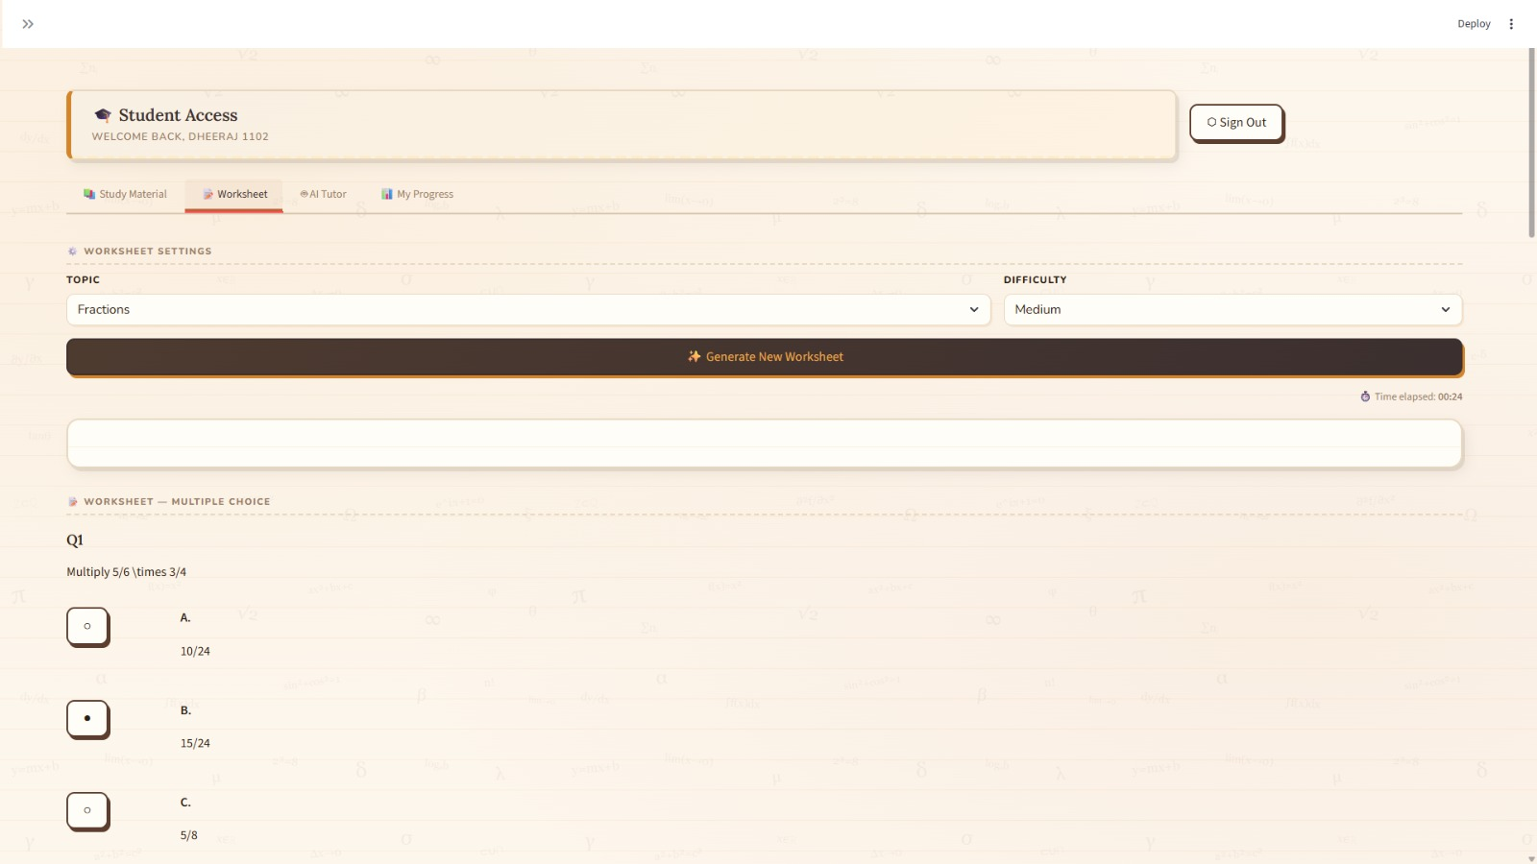
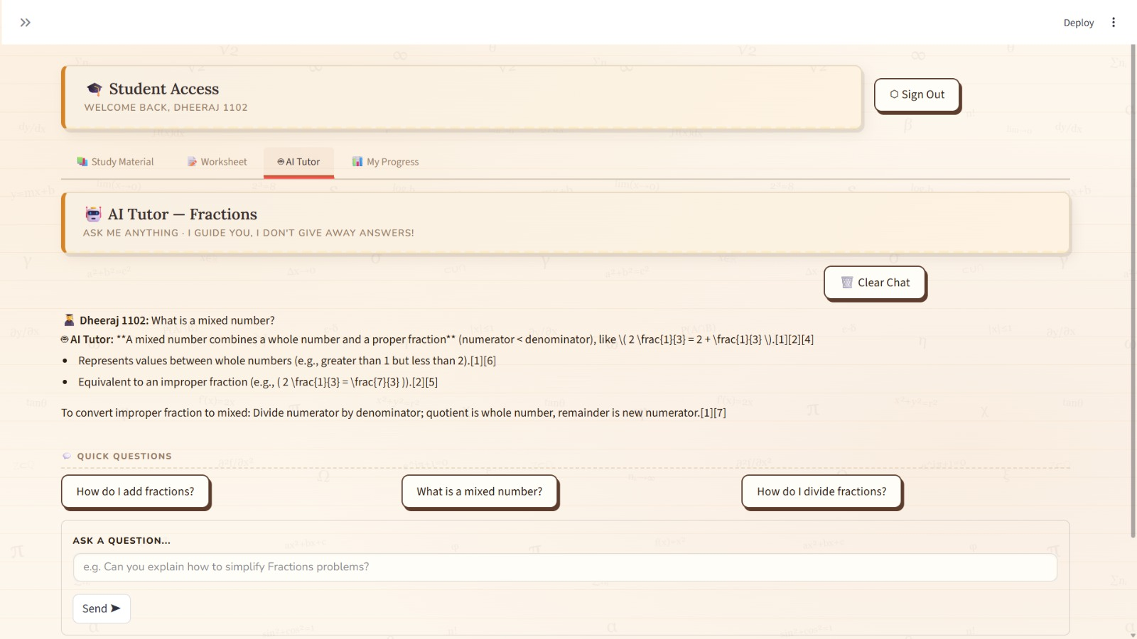
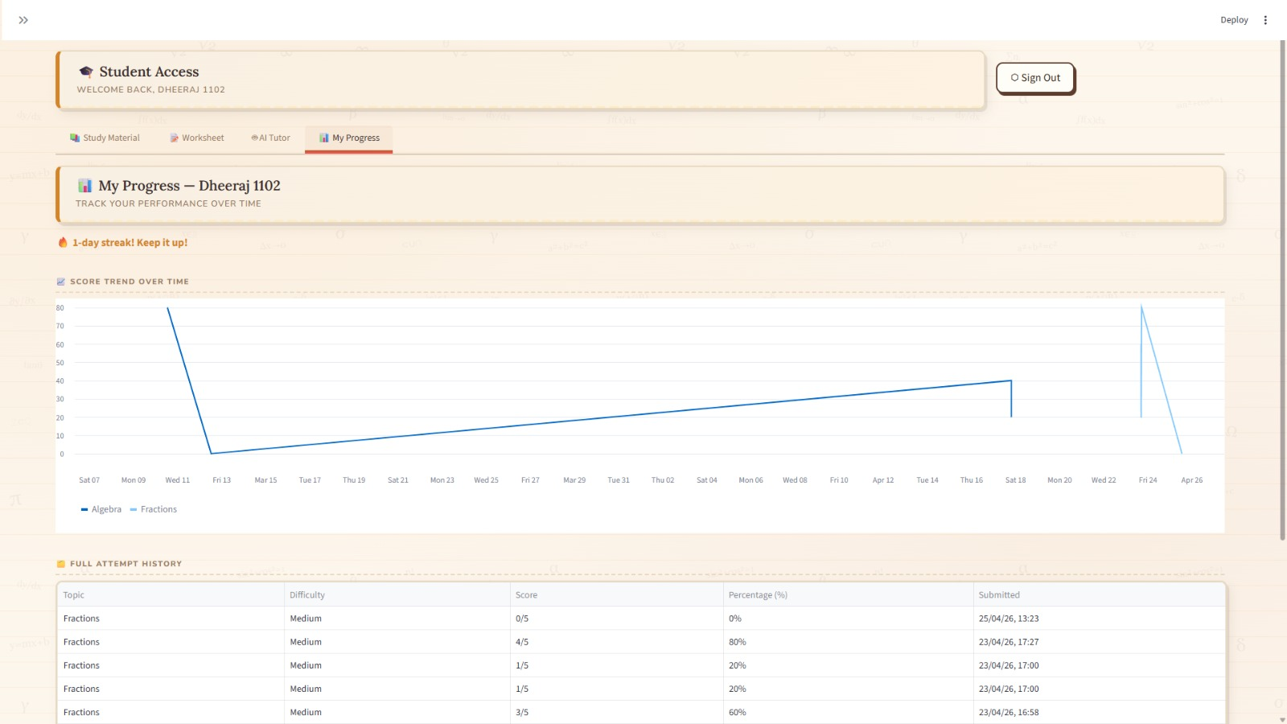
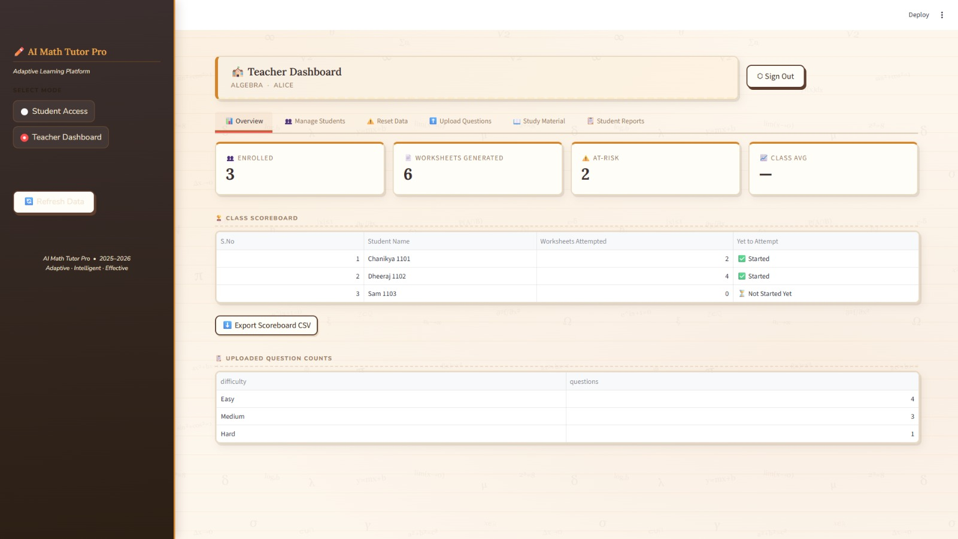
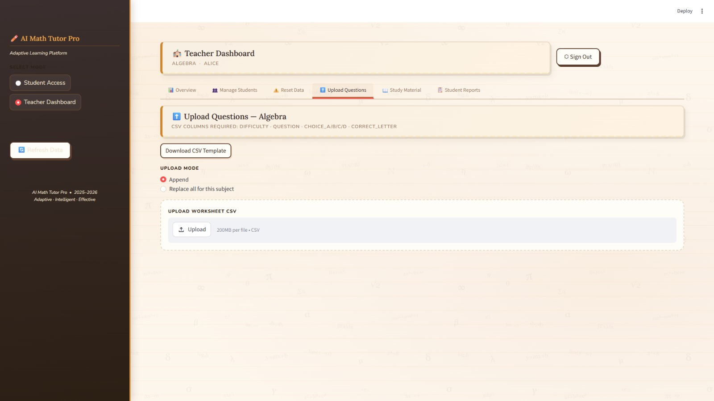
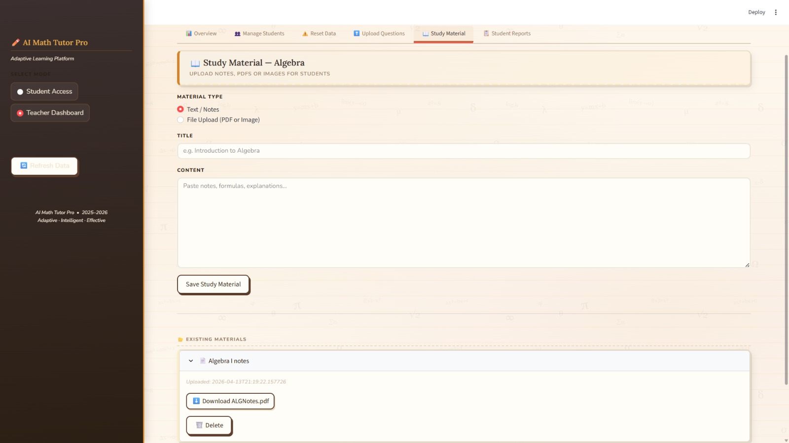
RESULT & ANALYSIS:

Slide 13
CONCLUSION:
AI Math Tutor Pro successfully delivers adaptive, AI-assisted math practice within a classroom-ready web application.
The dual-role design (student + teacher) bridges the gap between self-paced learning and instructor oversight.
Integration with Perplexity AI ensures unlimited, curriculum-aligned question generation beyond static banks.
The system is lightweight, deployable with minimal infrastructure, and extensible to other subjects.

Slide 14
FUTURE ENHANCEMENT:
Expand to advanced Mathematics topics with topic-specific AI prompting (Algebra, Geometry, Calculus, Statistics)
Add spaced-repetition scheduling to resurface weak topics automatically
Integrate voice-based tutoring using speech-to-text for accessibility
Deploy as a mobile app (Android/iOS) for offline worksheet access
Multi-language support (Tamil, Hindi) for regional school adoption

Slide 15
REFERENCES:
Liu et al. | 2024 | Generative Intelligent Tutoring Systems with GPT-4 | GPT-based tutors provide real-time adaptive feedback and dynamic content generation for personalized learning
Fernández-Herrero | 2024 | Affective Intelligent Tutoring Systems Review | Emotion-aware AI tutors enhance motivation, engagement, and learning effectiveness
Létourneau et al. | 2025 | AI-Driven Intelligent Tutoring Systems in K-12 Education | Rapid growth of AI tutoring shows significant improvements in learning outcomes and scalable education delivery
Hariyanto et al. | 2025 | AI in Adaptive Education | Adaptive learning algorithms personalize instruction using learner analytics and performance data
Latif, Liu & Zhai | 2026 | Intelligent and Robot Tutoring Systems Review | AI and robotic tutors expand interactive learning through advanced pedagogical design and automation

Slide 16
THANK YOU

